Slide 1
Proctoring Suggested Changes

Slide 2
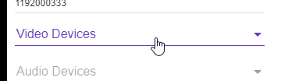
Video Devices
Issue/Fix
Screenshot
If the user disallows the Chrome plugin access, then the program will go on as normal.
If user disallows microphone and video access, then disallow them to continue. Kindly remind them how to re-enable access.

Slide 3
Screen Recording
Issue/Fix
Screenshot
Similarly to the screen recording, when disabling the app’s access to screen record, it simply continues while disregarding the screen recording.
If user disallows screen recording, then disallow them to continue. Kindly remind them how to re-enable access.

Slide 4
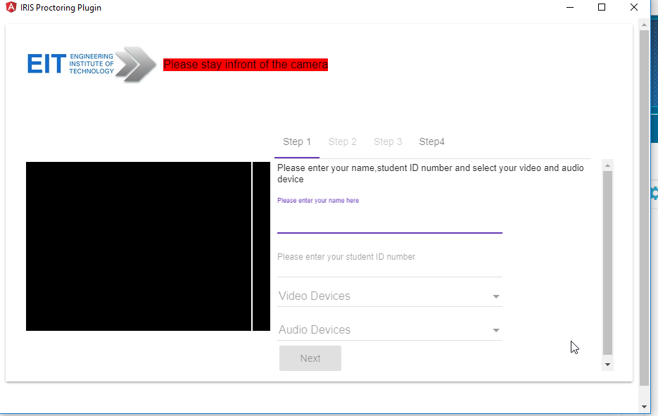
Overflow Issue
Issue/Fix
Screenshot
Too many scroll bars.
Can be fixed by hiding the overflow.
Alternatively resizing the popup window could be disabled.
Notes:
.mat-tab-body-content {
overflow: hidden;
}

Slide 5

Favicon
Issue/Fix
Screenshot
The Angular Favicon needs to be replaced.

Slide 6
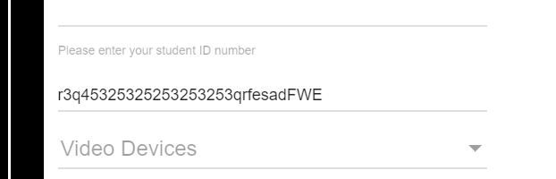
Student ID Validation
Issue/Fix
Screenshot
Students may accidentally enter there student IDs incorrectly.
Add a cap on the amount of characters allowed for Student ID / check if the ID is correct.

Slide 7
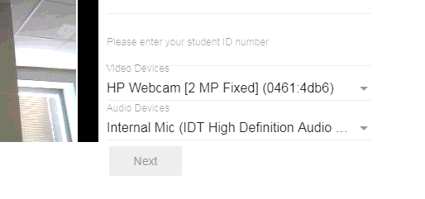
Video Device Selection
Issue/Fix
Screenshot
The recommended video device and audio device should be automatically selected.

Slide 8
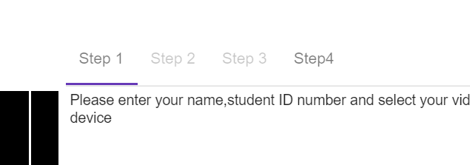
Video Devices
Issue/Fix
Screenshot
‘Step4’ is enabled, and has no spacing between the word ‘Step’ and ‘4’.
Gray out ‘Step4’, and add space between ‘Step’ and ‘4’.

Slide 9
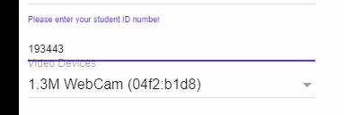
Input Field Clipping Issue
Issue/Fix
Screenshot
The input field covers the ‘Video Devices’ text when selected.
Add more spacing in between fields.

Slide 10
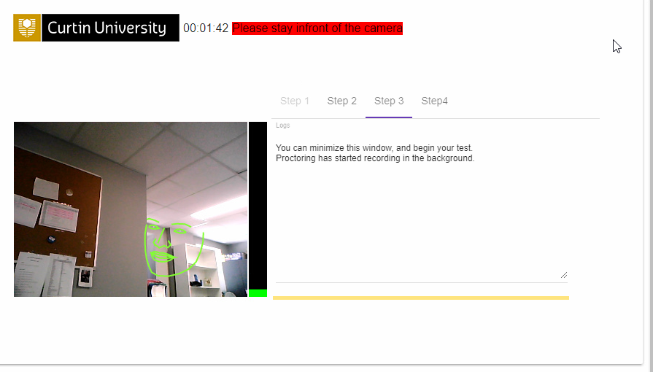
Recording Display
Issue/Fix
Screenshot
The student is allowed to view the face recognition modules.
Disable it completely. Just add the timer and confirm to the student that the proctoring is working.

Slide 11
Timing of Proctoring Popup
Issue/Fix
The Proctoring plugin popped up during an unrelated Curtin Quiz I undertook.
The Proctoring Plugin Popup needs to be optimised to pop up at the right tests. Ensure it only works for the right tests.

